Slide 1
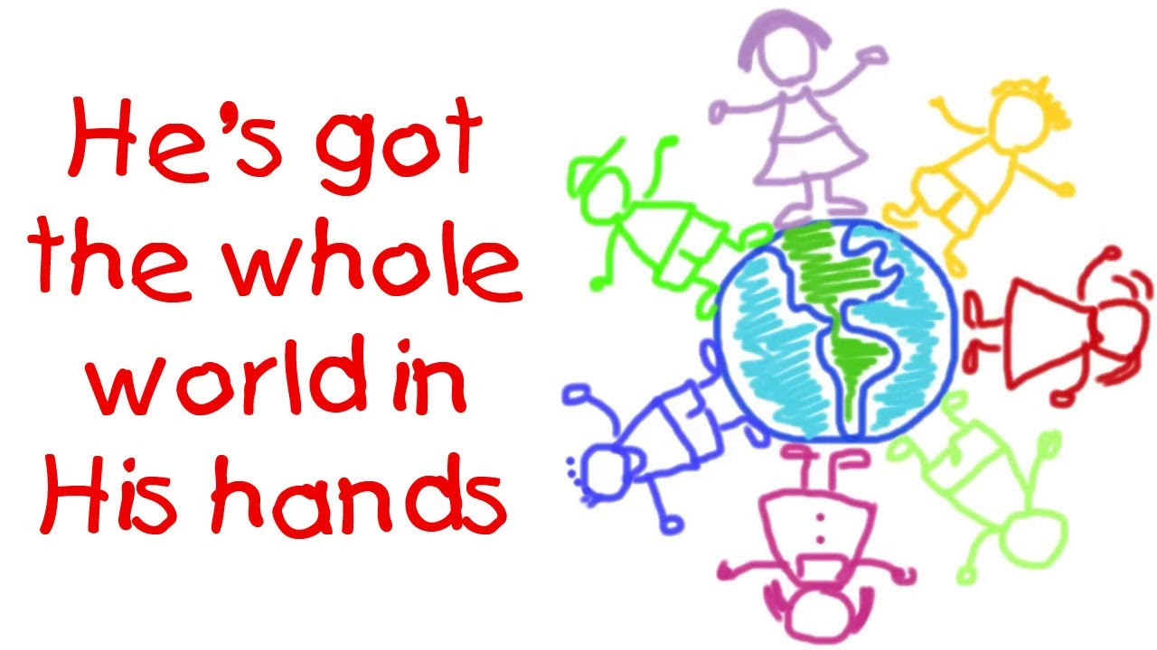

Slide 2
Got
Whole
World
Hands

Slide 3
Daddy Dad
Mommy Mom
Brother
Sister
Younger Brother
Younger Sister

Slide 4

He's got the whole world in His hands
He's got the whole world in His hands
He's got the whole world in His hands
He's got the whole world in His hands.

Slide 5

He's got you and me, daddy in His hands
He's got you and me, daddy in His hands
He's got you and me, daddy in His hands
He's got the whole world in His hands.

Slide 6

He's got you and me, mommy in His hands,
He's got you and me, mommy in His hands,
He's got you and me, mommy in His hands,
He's got the whole world in His hands.

Slide 7
He's got you and me, brother in His hands
He's got you and me, brother in His hands
He's got you and me, brother in His hands
He's got the whole world in His hands.

Slide 8
He's got you and me, sister in His hands,
He's got you and me, sister in His hands,
He's got you and me, sister in His hands,
He's got the whole world in His hands.

Slide 9
He's got you and me, family in His hands,
He's got you and me, family in His hands,
He's got you and me, family in His hands,
He's got the whole world in His hands.

Slide 10


